Slide 1

Agenda
Overview
Core Skills for Data Scientists
Statistical and Machine Learning Foundations
Advanced Tools and Technologies
Role Integration and Cross-Functional Collaboration

Slide 2

Data Science Roadmap 2024
Overview: Data science is the interdisciplinary field that uses scientific methods, algorithms, and systems to extract knowledge and insights from structured and unstructured data. it combines programming, statistical analysis, and domain expertise. Importance In Modern Industries: Data science drives decision-making by uncovering trends, optimizing operations, and enhancing customer experiences. industries like healthcare, finance, e-commerce, and technology rely on it for innovations such as predictive analytics, personalized marketing, and fraud detection, shaping their competitiveness in a data-driven world.

Slide 3
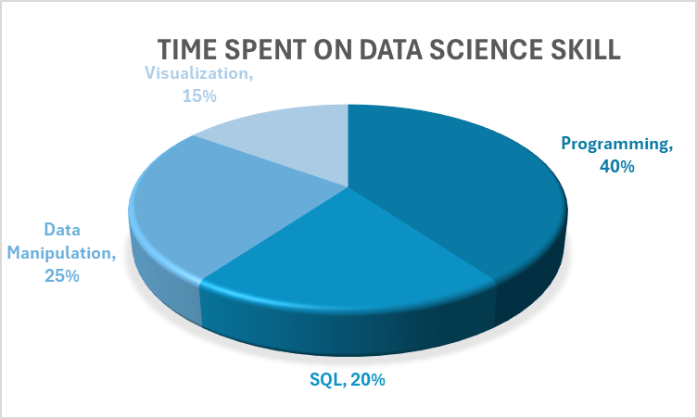
Core Skills for Data Scientists Programming (Python, R), SQL, data manipulation, and visualization.

Slide 4
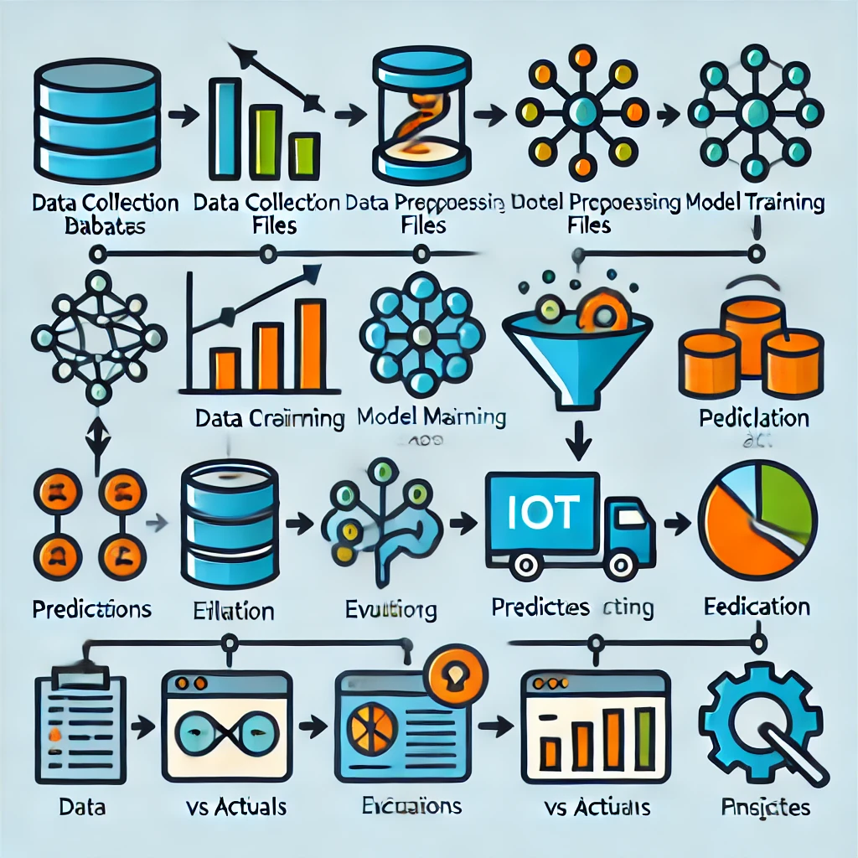
Statistics: Provides foundational tools to analyze data distributions, test hypotheses, and draw meaningful conclusions, ensuring data-driven accuracy. Machine Learning Models: Automates pattern detection and prediction, enabling scalable solutions for classification, regression, and clustering tasks. EDA: Facilitates understanding of data structure and relationships, uncovering trends, anomalies, and insights critical for model development and decision-making.
Statistical and Machine Learning Foundations
The machine learning workflow
Enhanced Workflow with Explanations
Data Collection:
Purpose: Gather raw data from various sources (databases, APIs, etc.).
Visual: Add icons for databases, files, or IoT devices to represent different data sources.
2. Data Preprocessing:
Purpose: Clean and prepare data (handle missing values, normalize).
Visual: Include a filter or funnel icon to represent cleaning and transformation.
3. Model Training:
Purpose: Use algorithms to learn patterns from training data.
Visual: Add an icon for a neural network or a cogwheel for "training.“
4. Evaluation:
Purpose: Test the model's accuracy and performance.
Visual: Show a graph comparing predictions vs. actual outcomes.
5. Predictions:
Purpose: Use the trained model for real-world data to generate predictions.
Visual: Include an arrow pointing to insights or output, such as charts or dashboards.

Slide 5



AI Tools: TensorFlow, Scikit-learn, and Keras for building and training machine learning models. Cloud Platforms: AWS (Amazon Web Services), Google Cloud Platform (GCP), and Microsoft Azure for scalable storage, computing, and AI services. Big Data Technologies: Hadoop, Apache Spark, and Snowflake for processing and analyzing large datasets. These technologies empower data scientists to handle complex datasets, deploy models, and derive valuable insights efficiently.
Advanced Tools and Technologies

Slide 6
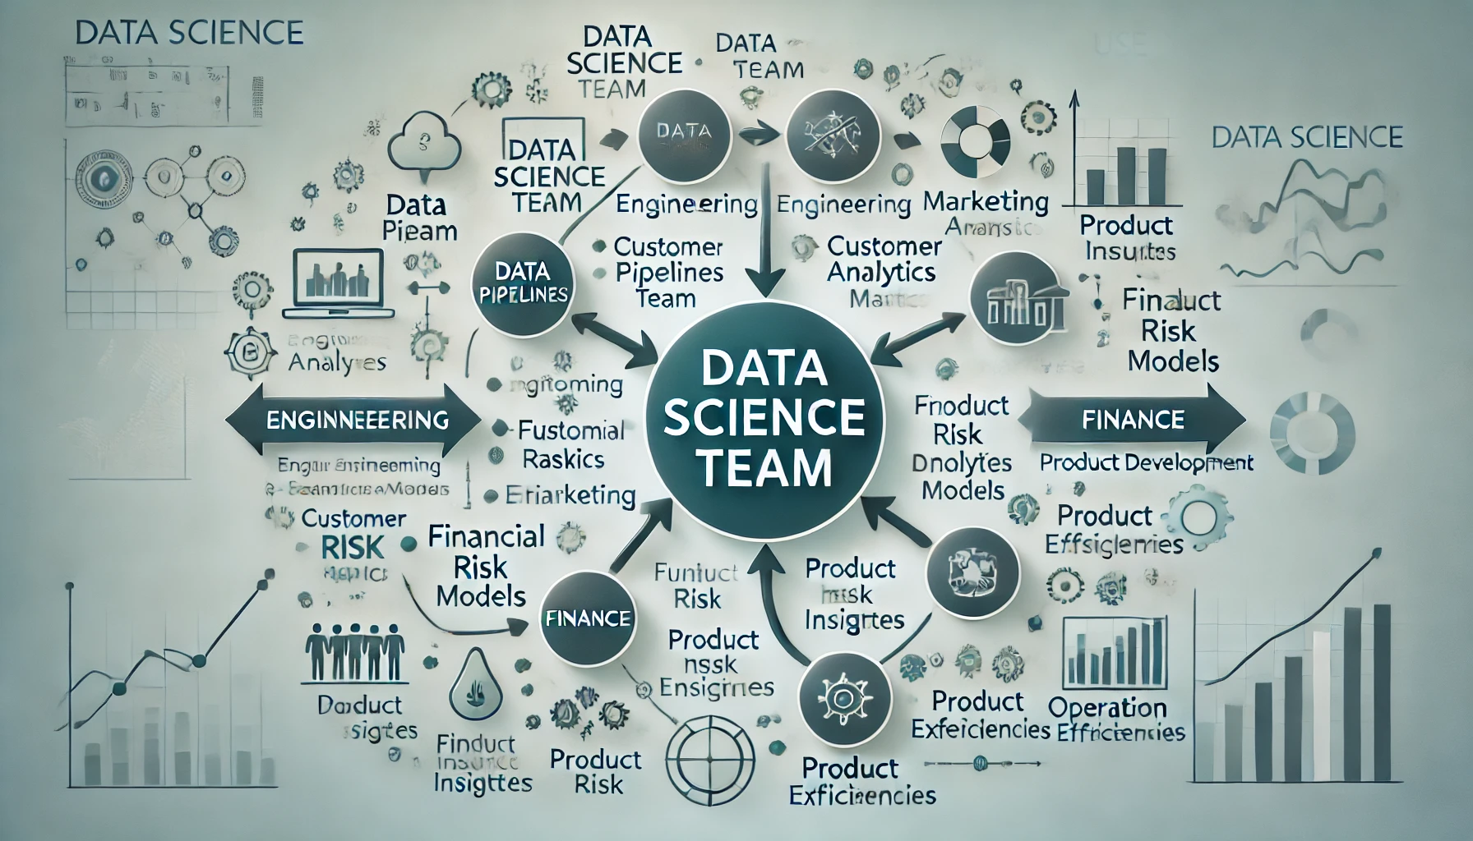
Role Integration and Cross-Functional Collaboration
Explanation for the Diagram
The image illustrates the Data Science Team as the central hub of collaboration.
Each arrow signifies the flow of insights and tools to and from the following teams:
Engineering: The team creates data pipelines and supports scalable model deployments.
Marketing: Receives customer segmentation and analytics to drive campaigns.
Finance: Leverages predictive models for risk assessment and revenue forecasting.
Product Development: Benefits from A/B testing insights and product usage analytics.
Operations: Gains efficiency through process optimization and resource planning tools.

Slide 7
Thank You

